Slide 1
Lecture 6 Activity Diagram
Chapter 20
The Unified Modeling Language User Guide
SECOND EDITION
By Grady Booch, James Rumbaugh, Ivar Jacobson
Session 14
UML Weekend Crash Course
Thomas A. Pender

Slide 2
Introduction
An activity diagram is essentially a flowchart, showing flow of control from activity to activity.
Unlike a traditional flowchart, an activity diagram shows concurrency as well as branches of control.
You use activity diagrams to model the dynamic aspects of a system. For the most part, this involves modeling the sequential and concurrent steps in a computational process.

Slide 3
Elements
Activity diagrams commonly contain:
Actions
Activity nodes
Flows
Object values

Slide 4
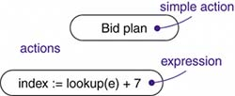
Actions and Activity Nodes
Actions: Atomic computations are called actions, like, call an operation on an object, send a signal to an object, or even create or destroy an object. Actions can't be decomposed (actions are atomic), meaning you can't execute part of an action; either it executes completely or not at all.

Slide 5

Actions and Activity Nodes
Activity: An activity node is an organizational unit within an activity. In general, activity nodes are nested groupings of actions or other nested activity nodes. Like, evaluate some expression that sets the value of an attribute or that returns some value.

Slide 6
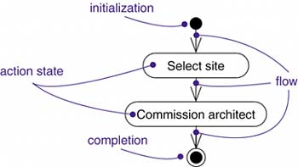
Control Flow
Control Flow: A flow is represented as a simple arrow from the predecessor action to its successor, without an event label. A flow of control has to start and end someplace

Slide 7
Guard condition and decision
Guard Condition:
Decision:

Slide 8
Merge Point, Start and End
Merge Point:
Start and End:

Slide 9
Concurrency
Forking and Synchronization: Number of outgoing concurrent flow out of a forking; must match with the number of incoming concurrent flow in its respective synchronization (joining).

Slide 10
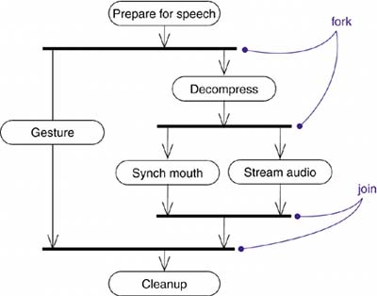
Concurrency (Example)

Slide 11
Swimlane
Swimlane: Modeling workflows of business processes, to partition the activity states on an activity diagram into groups, each group representing the business organization responsible for those activities. Each swimlane has a name unique within its diagram. A swimlane really has no deep semantics, except that it may represent some real-world entity, such as an organizational unit of a company.

Slide 12
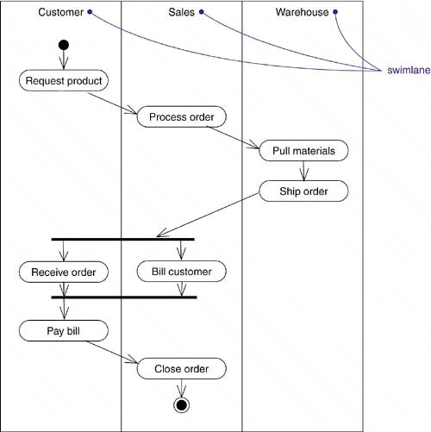
Swimlane (Example)

Slide 13
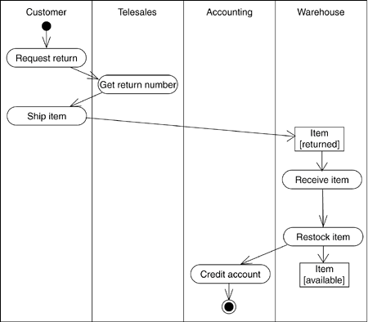
Object Flow
Objects may be involved in the control flow associated with an activity. Usually how the state of object changes is shown with object flow.

